Slide 1

Introduction to Machine Learning

Slide 2
What is Machine Learning
Machine learning is an application of artificial intelligence that involves algorithms and data that automatically analyse and make decision by itself without human intervention.
It describes how computer perform tasks on their own by previous experiences.
Therefore we can say in machine language artificial intelligence is generated on the basis of experience.

Slide 3
Normal Computer vs ML
The difference between normal computer software and machine learning is that a human developer hasn’t given codes that instructs the system how to react to situation, instead it is being trained by a large number of data.

Slide 4
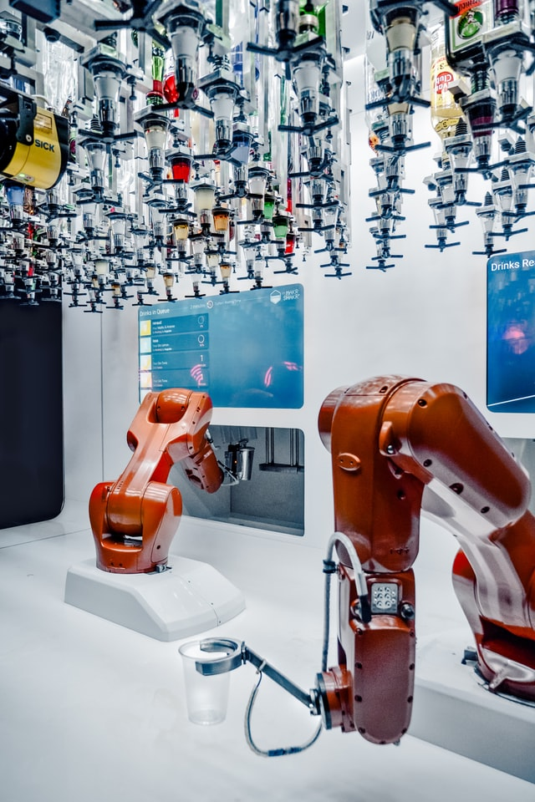
Some of the machine learning algorithms are:
Neural Networks
Random Forests
Decision trees
Genetic algorithm
Radial basis function
Sigmoid

Slide 5
Types of Machine Learning
There are three types of machine learning
Supervised learning
Unsupervised learning
Reinforcement learning

Slide 6
Machine Learning Uses:
Traffic prediction
Virtual Personal Assistant
Speech recognition
Email spam and malware filtering
Bioinformatics
Natural language processing

Slide 7
Real Time Examples for ML
TRAFFIC PREDICTION
VIRTUAL PERSONAL ASSISTANT
ONLINE TRANSPORTATION
SOCIAL MEDIA SERVICES
EMAIL SPAM FILTERING
PRODUCT RECOMMENDATION
ONLINE FRAUD DETECTION

Slide 8
Supervised learning
Supervised learning is a technique where the program is given labeled input data and the expected output data. Here machine learns under the guidance. It gets the data from training data containing sets of examples. They generate two kinds of results :
Classification: They notify the class of the data it is presented with (grouping the output into a class). Ex- to predict the gender
Regression: they expect the product to produce a numerical value. It means to predict the output value using training data. Ex- to predict house price
UNSUPERVISED LEARNING
To act without any supervision. This type of algorithm consists of input data without labeled response. There will not be any pre existing labels and human intervention is also less. It is mostly used in exploratory analysis as it can automatically identify the structure in data.
REINFORCEMENT LEARNING
This model is used in making a sequence of decisions. It is an learning by interacting with the environment. It is based on the observation that intelligent agents tend to repeat the action that are rewarded for and refrain from action that are punished for. It can be said that it is an trail and error method in finding the best outcome based on experience.

Slide 9
Machine Learning as a process
Define Objectives
Data Preparation
Model Building
Model Deployment
Model Evaluation
- Define measurable and quantifiable goals
- Use this stage to learn about the problem
Study models accuracy
- Work better than the naïve approach or previous system
Do the results make sense in the context of the problem
- Data Splitting
Features Engineering
Estimating Performance
Evaluation and Model Selection

Slide 10
Data Preparation
Needed for several reasons
Some Models have strict data requirements
Scale of the data, data point intervals, etc
Some characteristics of the data may impact dramatically on the model performance
Time on data preparation should not be underestimated
Raw Data
Data Transformation
Data Ready
Scaling
Centering
Skewness
Outliers
Missing Values
Errors
Missing Values
Dimensionality
Types Problems
Error Values
Different Scales
Many others
Modeling phase

Slide 11
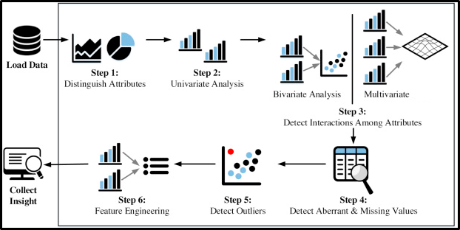
Feature Engineering
Determine the predictors (features) to be used is one of the most critical questions
Some times we need to add predictors
Reduce Number:
Fewer predictors more interpretable model and less costly
Most of the models are affected by high dimensionality, specially for non-informative predictors
Binning predictors

Slide 12
Model Building
Data Splitting
Allocate data to different tasks
model training
performance evaluation
Define Training, Validation and Test sets
Feature Selection (Review the decision made previously)
Estimating Performance
Visualization of results – discovery interesting areas of the problem space
Statistics and performance measures
Evaluation and Model selection
The ‘no free lunch’ theorem no a priory assumptions can be made
Avoid use of favorite models if NEEDED

